Slide 1
Solving problems by searching

Slide 2
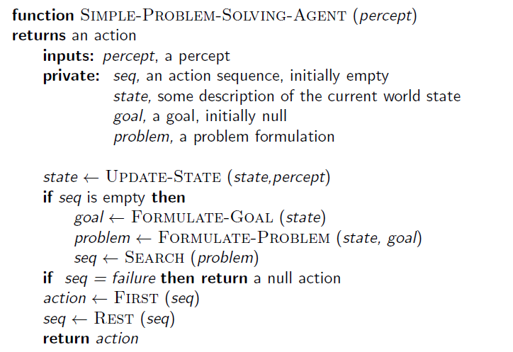
Problem solving agents

Slide 3
Example: Measuring problem
9 l
5 l
3 l
Problem: Using these three buckets,
measure 7 liters of water.

Slide 4
Example: Measuring problem
Measure 7 liters of water using a 3-liter, a 5-liter, and a 9-liter buckets.
Formulate goal: Have 7 liters of water
in 9-liter bucket
Formulate problem:
States: amount of water in the buckets
Operators: Fill bucket from source, empty bucket
Find solution: sequence of operators that bring you
from current state to the goal state

Slide 5
Example: Measuring problem
Solution:
a b c
0 0 0 start
0 5 0
0 0 3
3 0 3
0 0 6
3 0 6
0 3 6
3 3 6
1 5 6
0 5 7 goal
9 l
5 l
3 l
a
b
c

Slide 6
Example: Measuring problem
Solution:
a b c
0 0 0 start
0 5 0
3 2 0
0 0 3
3 0 3
0 0 6
3 0 6
0 3 6
3 3 6
1 5 6
0 5 7 goal
9 l
5 l
3 l
a
b
c

Slide 7
Example: Measuring problem
Solution:
a b c
0 0 0 start
0 5 0
3 2 0
3 0 2
3 0 3
0 0 6
3 0 6
0 3 6
3 3 6
1 5 6
0 5 7 goal
9 l
5 l
3 l
a
b
c

Slide 8
Example: Measuring problem
Solution:
a b c
0 0 0 start
0 5 0
3 2 0
3 0 2
3 5 2
0 0 6
3 0 6
0 3 6
3 3 6
1 5 6
0 5 7 goal
9 l
5 l
3 l
a
b
c

Slide 9
Example: Measuring problem
Solution:
a b c
0 0 0 start
0 5 0
3 2 0
3 0 2
3 5 2
3 0 7 goal
3 0 6
0 3 6
3 3 6
1 5 6
0 5 7 goal
9 l
5 l
3 l
a
b
c

Slide 10
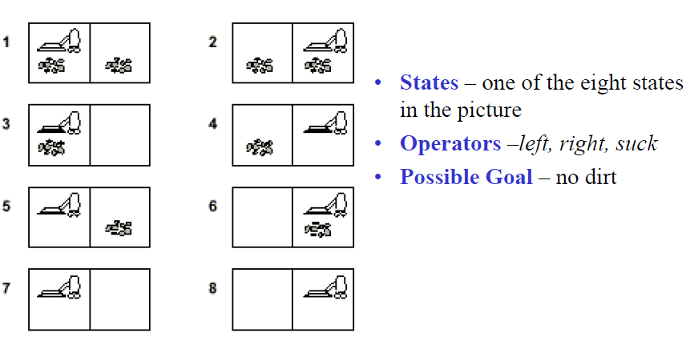
Vacuum World Problem

Slide 11
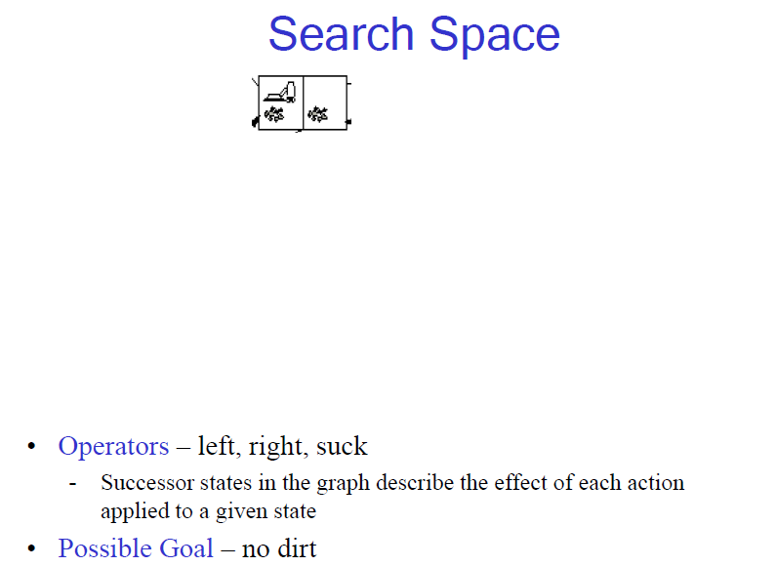

Slide 12
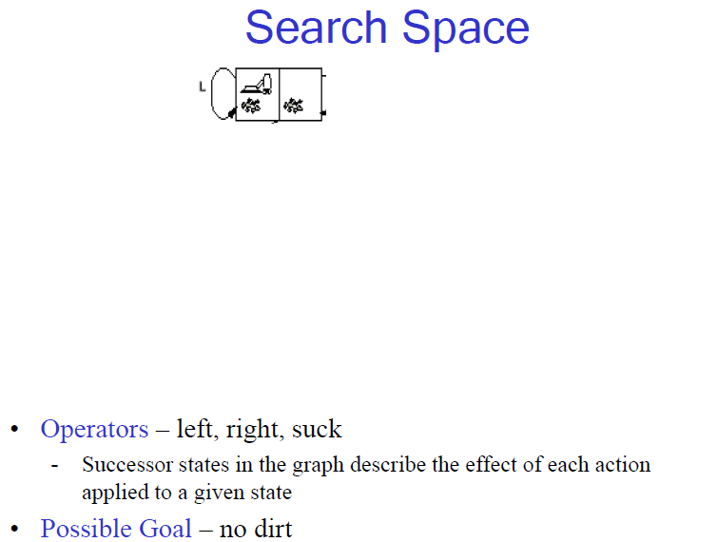

Slide 13
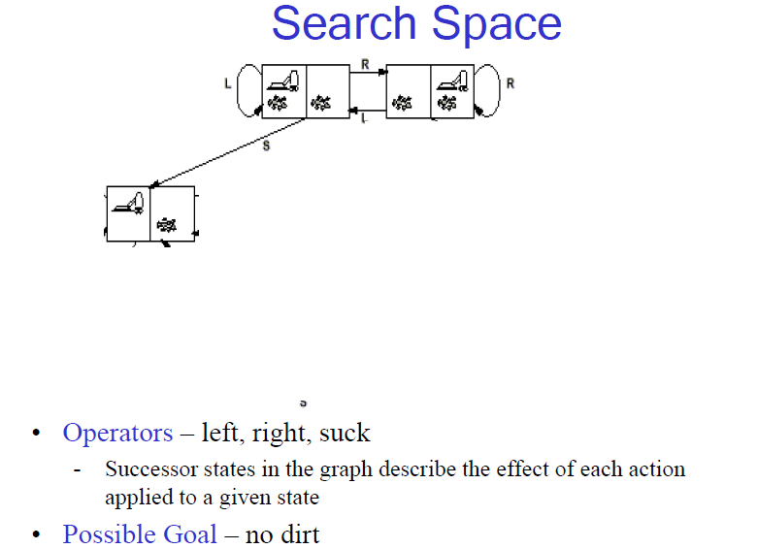

Slide 14
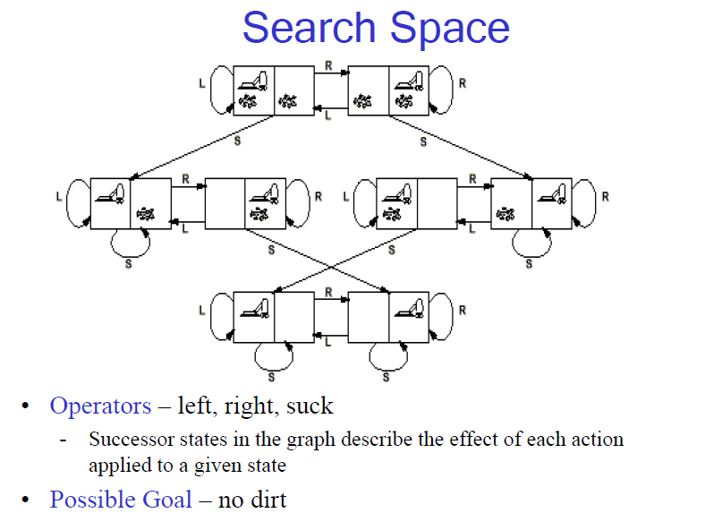

Slide 15
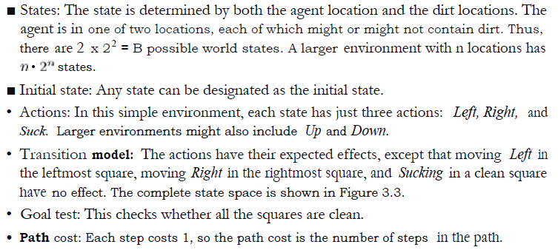

Slide 16
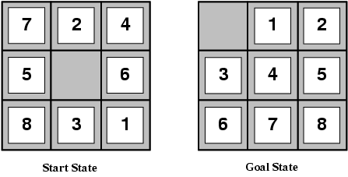
Example: 8-puzzle

Slide 17
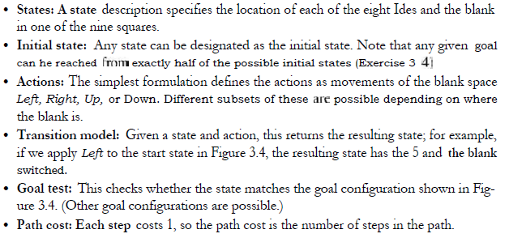
Example: 8-puzzle

Slide 18
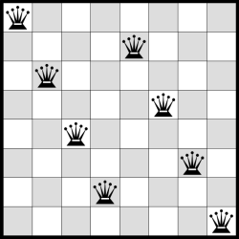
8 Queens Problem

Slide 19
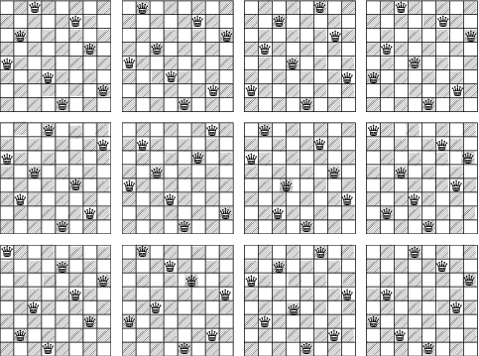
8 Queens solution

Slide 20
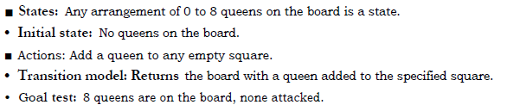
8 Queens Problem

Slide 21
Map colouring
You have to color a planar map using only four colors, in such a way that no two adjacent regions have the same color.

